Slide 1
HAND GESTURE PRESENTATION USING OpenCV
.

Slide 2
Table of contents
1.What is Gesture ?
2.What is hand gesture recognition?
3.Task accomplished?
4.Hand symbol representation?
5.Challenges Faced?
6.Future Scope?
7.Hand Gesture based applications?

Slide 3
What is gesture ?
Non Verbal communication
Gives message
A gesture is a movement that you make with a part id your body, especially your hands , to express emotion or information.
Motion of body that contains information.

Slide 4
What is hand gesture recognition ?
Hand gesture are a kind of body language in which the position and shape of the center of the palm and the fingers communicate specific information.
Gesture is made up of both static and dynamic hand movements.
Dynamic hand gestures are made up of series of hand movements. Dynamic hand gestures rely on the movements of the hands to transfer the meaning.
Static hand gesture are based only on the shape of the hand. Static hand gestures rely on the shape of the hand gesture to convey the message.

Slide 5
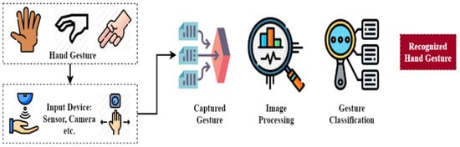
General framework about hand gesture recognition

Slide 6
Task accomplished
Recognized various gestures and applied them as input to computer
Converted gestures into commands and perform related task in real-time.
Deployed on single precision sampling
Trained the system for identification of gestures

Slide 7
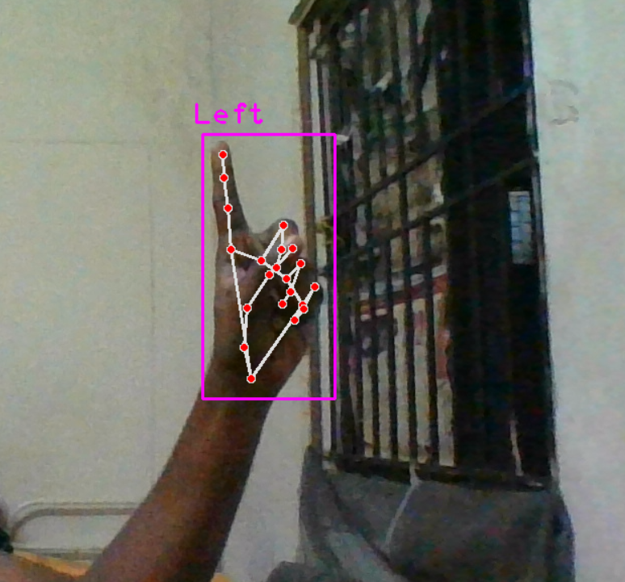
Symbol Representation
Index Finger
Index finger used to mark or draw or
underline any Specific text or paragraph.

Slide 8
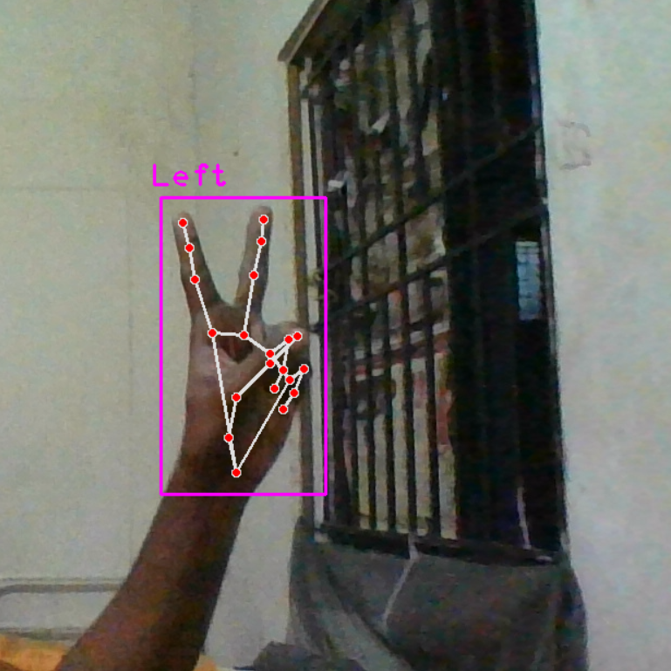
Symbol Representation
Index finger and Middle finger
It is used to move the pointer to anywhere in
the Screen and mark it with index finger.

Slide 9
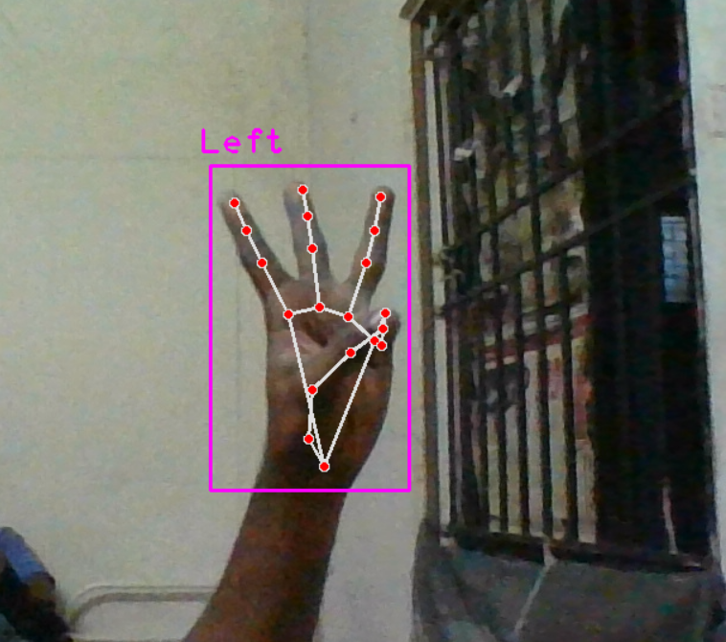
Symbol Representation
Index , middle and ring finger
These fingers is used to erase the content
that we Written on the screen.
By closing the three fingers we can erase
the Content.

Slide 10
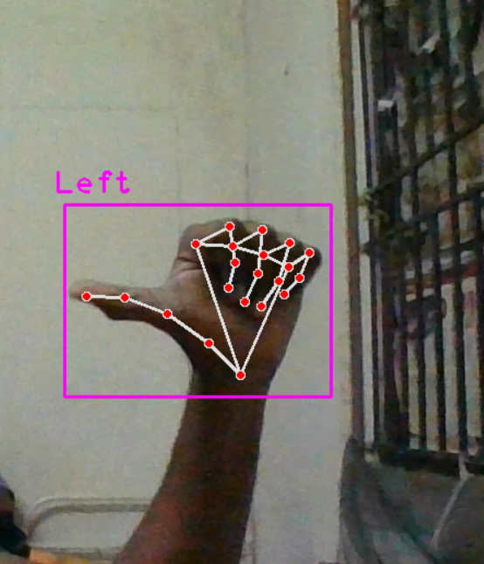
Symbol Representation
Thumb finger
Thumb finger used to move back the slide of the screen.
Just show once the thumb finger it can move one slide.
Continuously showing the thumb finger it goes backward
without any pause.

Slide 11
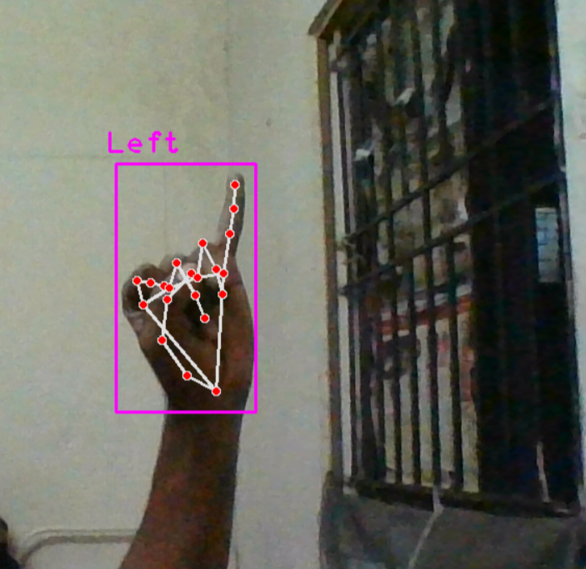
Symbol Representation
Little finger
Little finger used to move the next slide.
Just show once the little finger it can move one
slide.
Continuously showing the little finger it goes
backward without any pause.

Slide 12
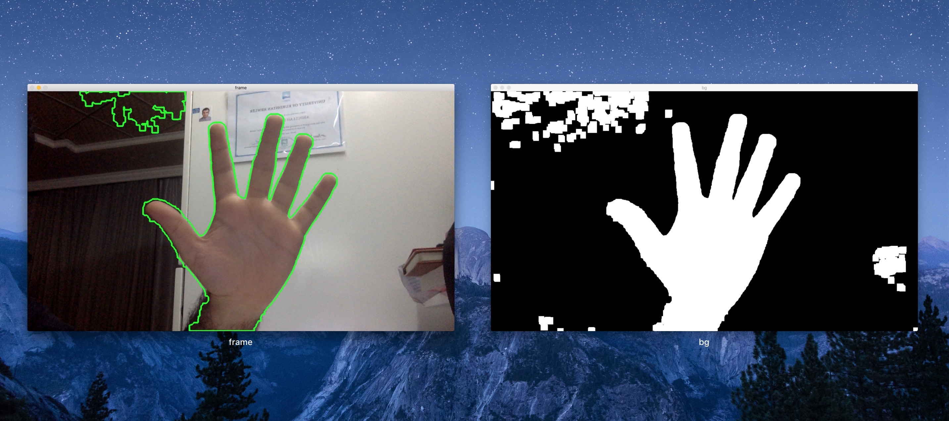
Challenges Faced
Background Removal
This Photo by Unknown Author is licensed under CC BY-SA

Slide 13
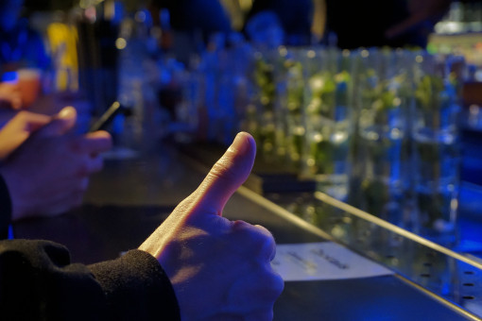
Challenges Faced
Lighting Conditions

Slide 14
Future Scopes
Provide editing mechanism by using Gestures
Apply gesture recognition for accessing internet applications
Implementing more number of gestures
Achieving more accuracy
Enhance the recognition capability for various lighting conditions

Slide 15
Hand Gestures based applications
Translation of gestures to commands
More natural interface for 3D design applications
Useful for disabled and deaf people
Sign language analysis , translation
Sign language teaching
Using multimodality to enable communication between disabled people

